Slide 1

Steganography of Messages
Encrypted With QR Code
GUIDE:
MRS. RAJYA LAKSHMI
TEAM MEMBERS:
M. Sravan kumar(22P61a6232)
J. Varun(22P61A6218)
P. Nikhila (22P61A6246)
G. Shravan Kumar(22P61A6212)

Slide 2
ABSTRACT:
This project implements a secure data-hiding technique using ECC(Elliptic curve cryptography), QR codes, and steganography. The system encrypts a secret message using the ECC(Elliptic curve cryptography), encodes it as a QR code, and embeds the QR code into a cover image using Least Significant Bit (LSB) steganography. The recipient extracts the hidden QR code, decodes the encrypted message, and decrypts it using the key. This method ensures data confidentiality, integrity, and security, making it suitable for secure communication, digital forensics.

Slide 3
INTRODUCTION
In the digital era, data security is crucial. Traditional encryption protects data but doesn't hide its presence, making it vulnerable to attacks. Steganography enhances security by concealing encrypted data within images.
This project combines ECC encryption, QR code storage, and LSB-based image steganography to securely hide and transmit sensitive information. ECC ensures strong encryption, QR codes enable easy data storage, and LSB steganography conceals the QR code within an image. This approach provides a secure and efficient way to share confidential information over untrusted networks.

Slide 4
System Requirements:
Software Requirements
Operating System: Windows, Linux, or macOS
Python Version: Python 3.7+
Hardware Requirements
Processor: Intel i3 or equivalent (minimum)
RAM: 4GB (minimum), 8GB+ recommended
Storage: At least 100MB for image and QR code storage
Camera/Scanner (Optional): For scanning QR codes from printed images

Slide 5
Existing System:
Traditional Cryptographic Methods
QR Code Vulnerability
Steganographic Methods
Lack of Multi-Layered Security

Slide 6
Proposed System:
Integration of ECC, QR Codes, and Steganography
Efficient and Secure Encryption: Uses Elliptic Curve Cryptography (ECC) for strong security with lower computational requirements.
QR Codes for Structured Data Storage
Steganography for Concealment
Multi-Layered Security Approach

Slide 7
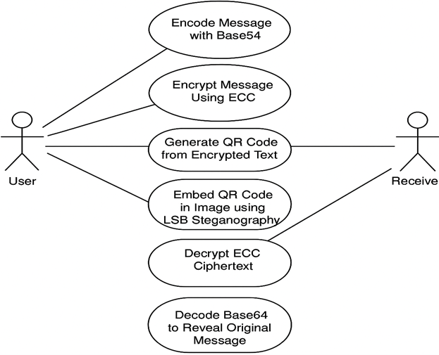
SYSTEM DESIGN:
USE CASE DIAGRAM

Slide 8
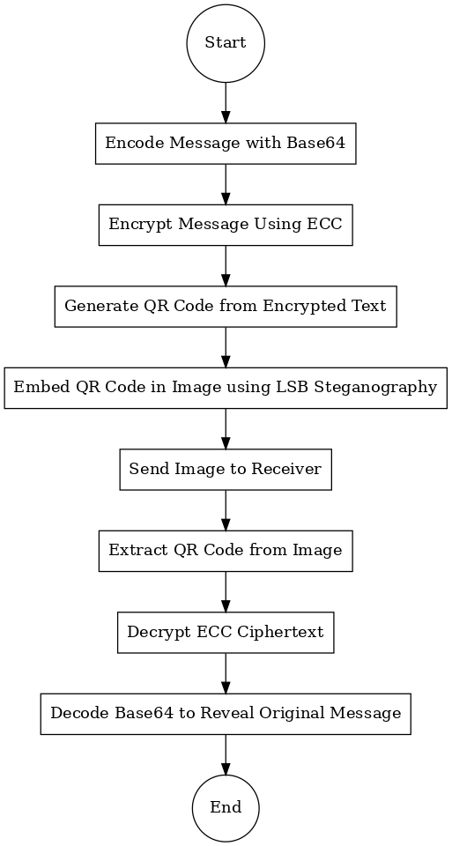
ACTIVITY DIAGRAM

Slide 9
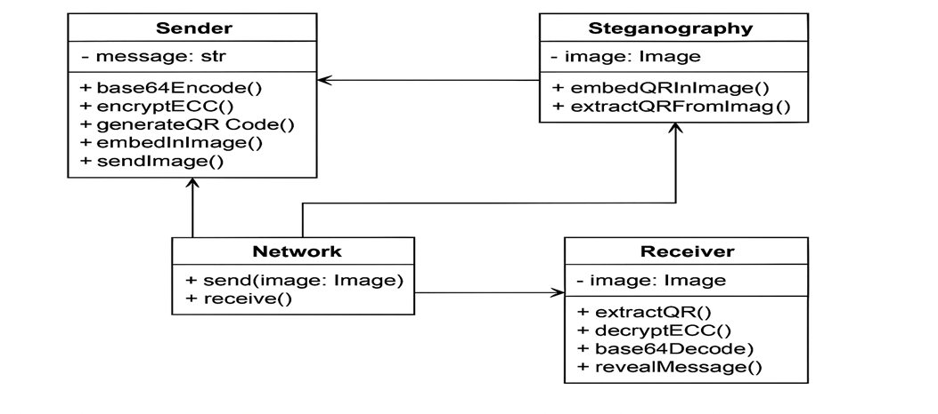
CLASS DIAGRAM

Slide 10
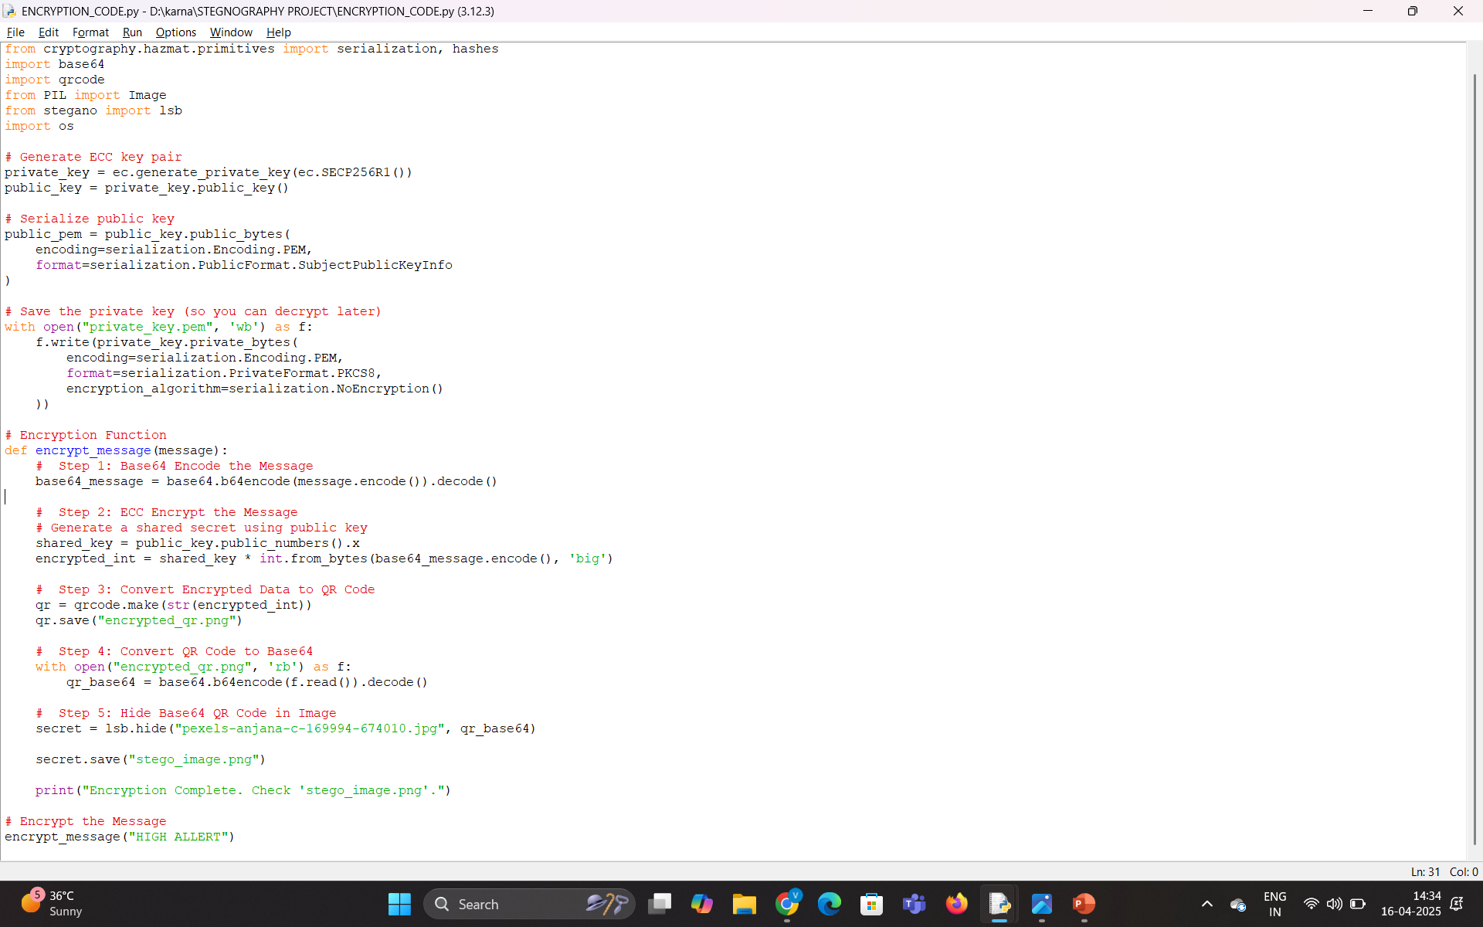
Encryption Code

Slide 11
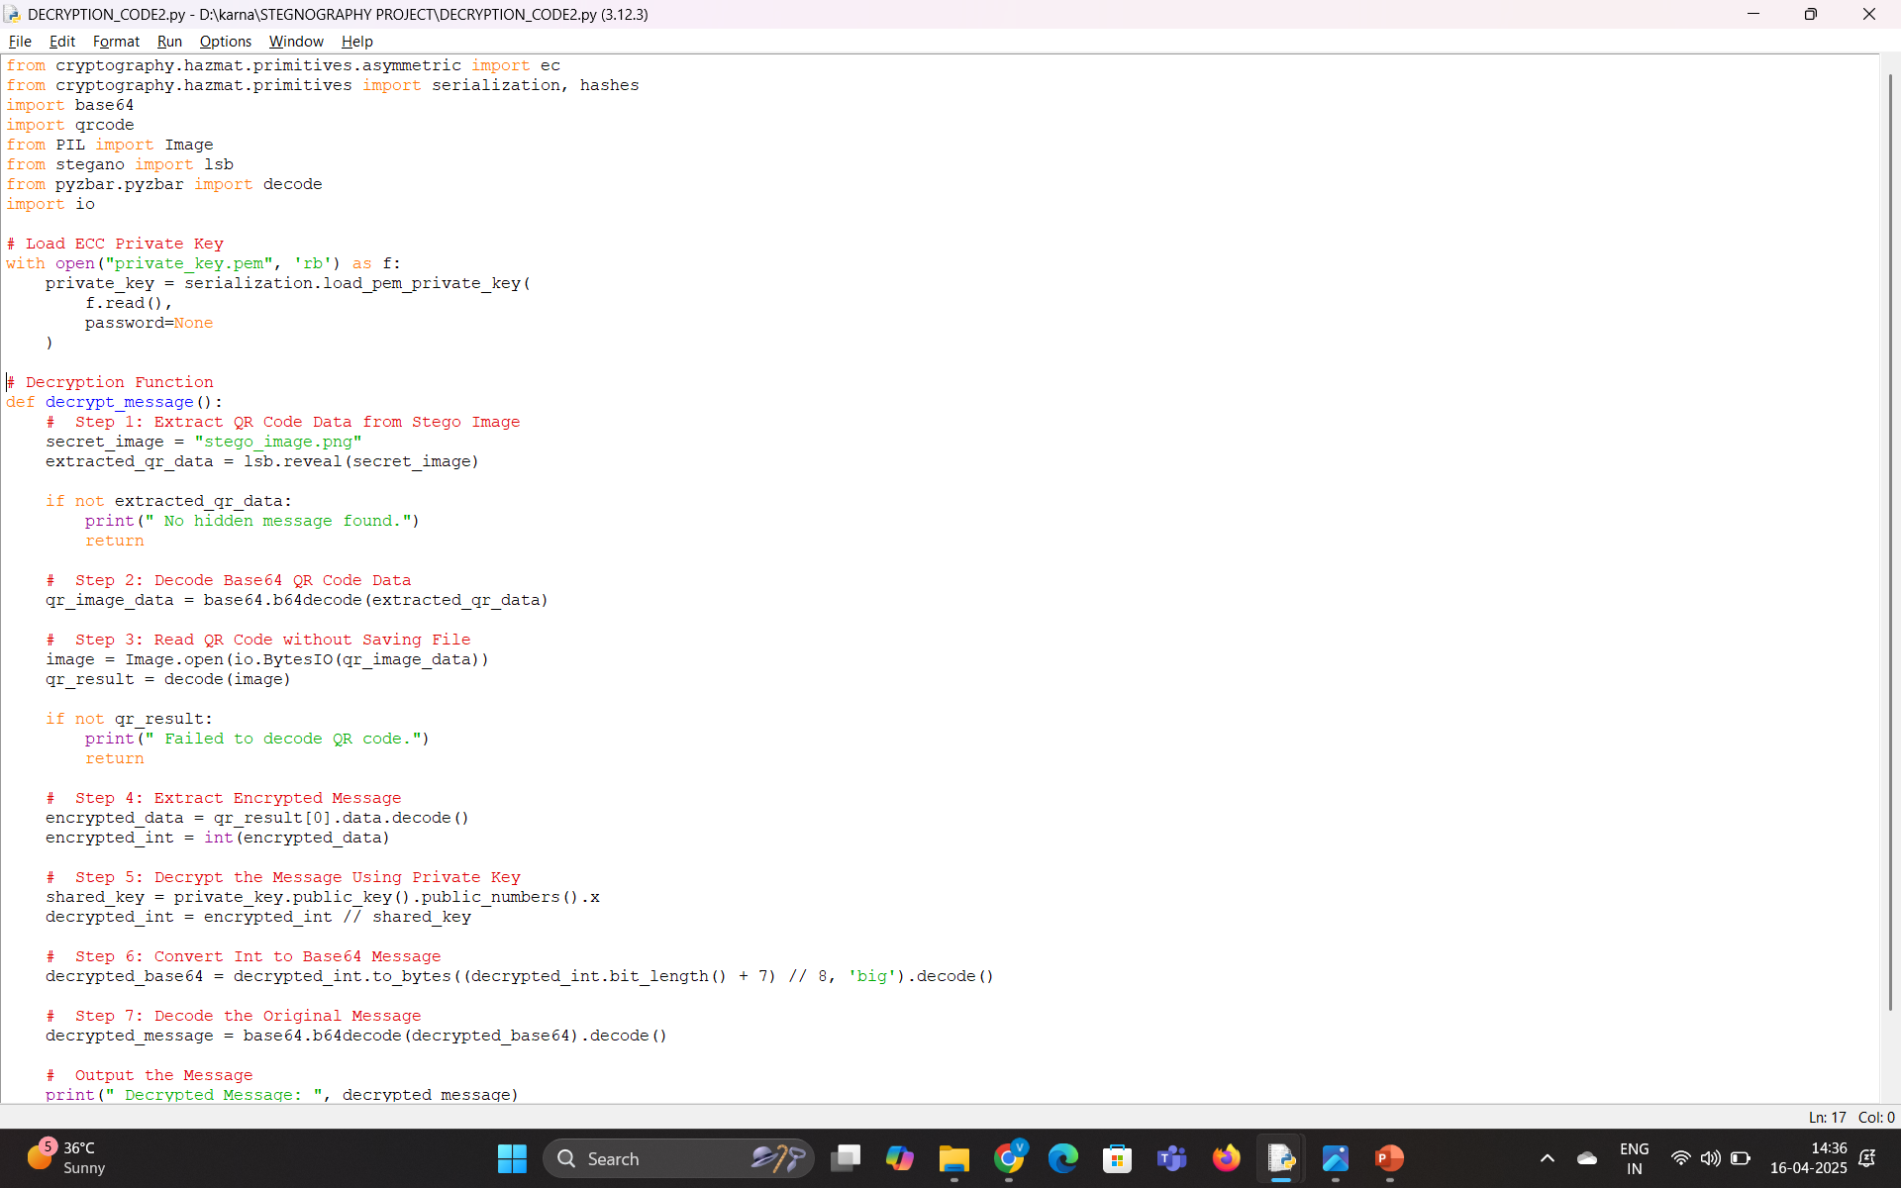
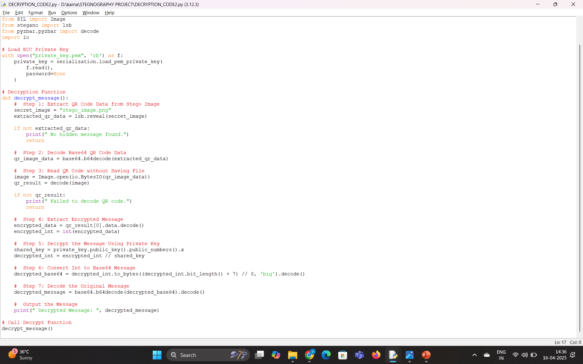
Decryption Code

Slide 12
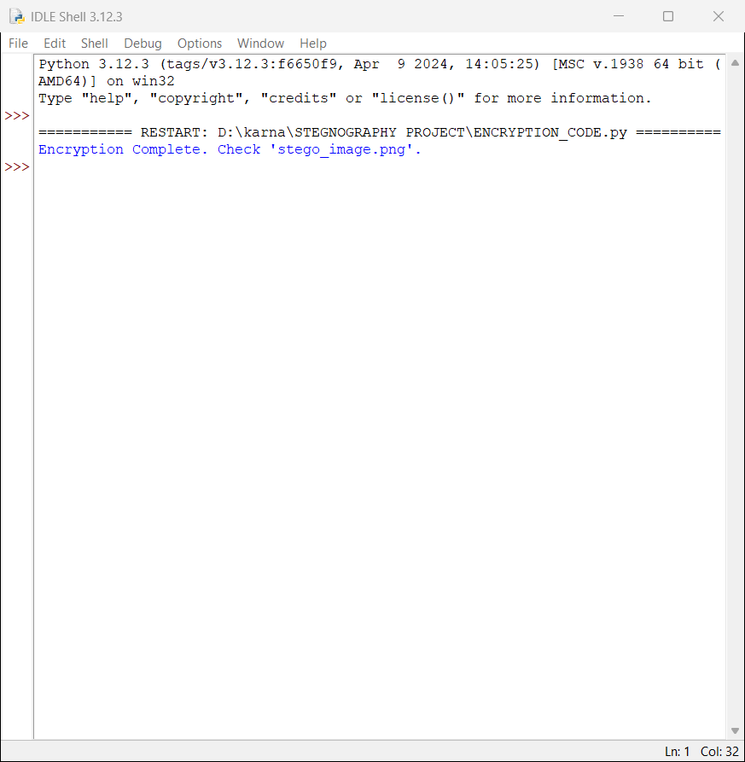
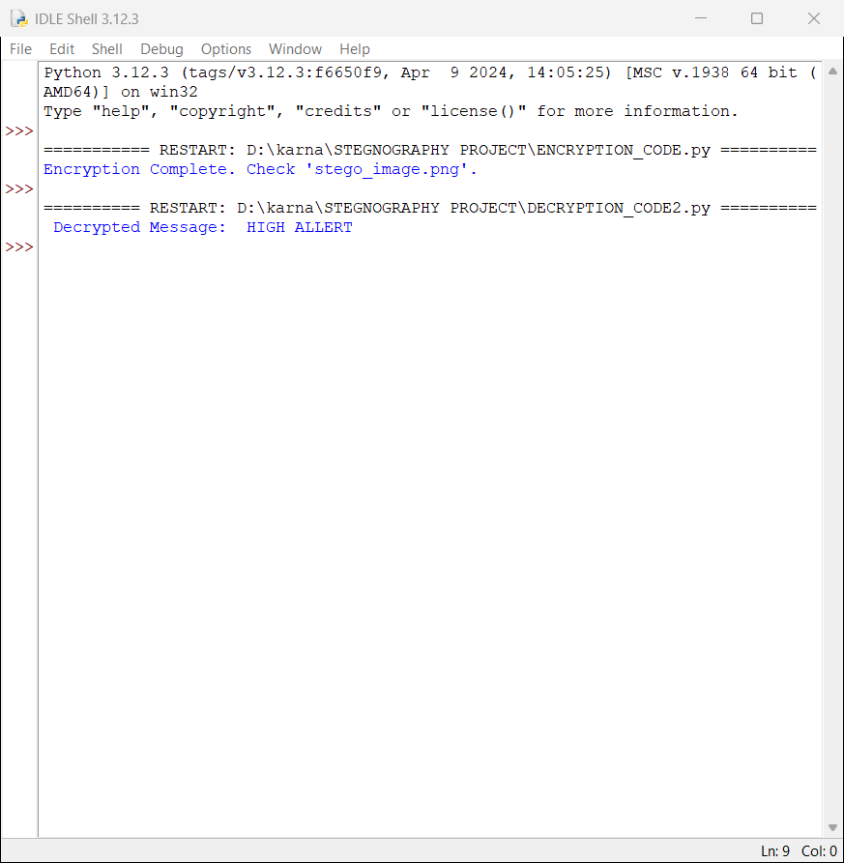
OUTPUT SCREENS
ENCRYPTION OUTPUT
DECRYPTION OUTPUT

Slide 13
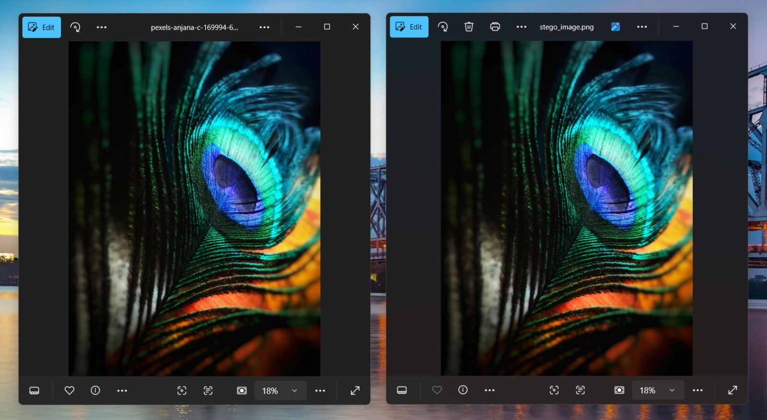

GENERATED QR
IMAGE
STEGO IMAGE

Slide 14
s.no | Year | authors | title | publications | Key findings | Methodologies | Gaps identified
1 | March 2021 | D Betteena Sheryl Fernando | Steganography of Messages Encrypted With QR Code | International Journal of Computer Science Engineering and Information Technology. | Integration of Steganography and Encryption Use of QR Code as a Steganographic Carrier | QR Code as the Cover Medium LSB (Least Significant Bit) Steganography | Limited Analysis of Steganalysis Resistance 2. Scalability and Efficiency Concerns
2 | February 2020 | Deepak Singla | data security and integrity using data hiding | International Journal of Computer Science Engineering and Information Technology. | Integration of Steganography and Cryptography Random LSB Insertion Method | Random LSB Insertion Controlled by Secret Key Encryption Prior to Embedding | Lack of Performance Evaluation Scalability and Payload Capacity
3 | February 2020 | Osama S.Faragallah | Steganography of Encrypted Messages Inside Valid QR Codes | International Journal of Computer Science Engineering and Information Technology | Dual-Purpose QR Codes Unrelated Message and Payload | QR Code as a Steganographic Container Encryption of Payload | Resistance to Advanced Steganalysis Payload Capacity Limitations
4 | July 2017 | Mohammad Soltani | A New Secure Hybrid Algorithm for QR-Code Images Encryption and Steganography | APTIKOM Journal on Computer Science and Information Technologies. | Hybrid Encryption Approach Steganography via LSB Technique | QR Code Generation Image Encryption | Performance Metrics Robustness to Attacks

Slide 15
5 | June 2018 | Amna Elhawil | Steganography Technique to Hide a Secret Message in QR Code | International Journal of Computer Science Engineering and Information Technology. | Challenges in QR Code Steganography Steganographic Approach | QR Code Structure Analysis Secret Message Encoding | Does not incorporate cryptographic encryption Limited robustness testing against attacks
6 | January 2021. | Shashi Kiran B S , K. Shaila | Hybrid Domain Steganography for Embedding DES Encrypted QR Code Using Random Bit Binary Search | Lecture Notes of the Institute for Computer Sciences . | Hybrid Domain Approach Multi-Level Security | DES Encryption QR Code Generation | Computational Overhead Lack of Comparative Analysis

Slide 16
THANK YOU

